Slide 1
Antonio Fasano
Dipartimento di Matematica U. Dini, Univ. Firenze
IASI – CNR Roma
A new model for blood flow in capillaries

Slide 2
FASANO, A. FARINA, J. MIZERSKI.
A new model for blood flow in fenestrated capillaries with application to ultrafiltration in kidney glomeruli, submitted

Slide 3
Blood composition
7% of the human body weight,
average density of approximately 1060 kg/m³
average adult blood volume 5 liters
plasma 54.3%
RBC’s (erythrocytes) 45%
WBC’s (leukocytes) 0.7%
platelets (thrombocytes) negligible volume fraction

Slide 4
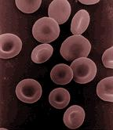
RBC’s properties
Volume
V_{RBC} ∼ 90 μm³
Diameter
d_{RBC} ∼ 7÷8 μm
Very flexible

Slide 5
Quoting from
G. Mchedlishvili, Basic factor determining the hemorheological disorders in the microcirculation, Clinical Hemorheology and Microcirculation 30 (2004) 179-180.
the available fluid mechanical laws cannot be applied for a better understanding of the microcirculation in the living capillaries, and the hemorheology in the microcirculation requires another approach than regularities of the fluid mechanics

Slide 6
General trend:
Adapting rheological parameters to the vessel size

Slide 7
Our model ignores fluid dynamics
and
considers just Newton’s law

Slide 8
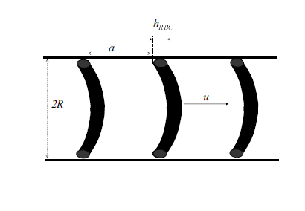
Translating sequence of RBCs and plasma elements
Translating element
Driving force
Pressure gradient
drag
The drag is due to the highly sheared plasma film

Slide 9
Translating sequence of RBCs and plasma
Translating element
Driving force
a/R ∼ 1/3 when the hematocrit is 0.45
Pressure gradient
drag
The drag is due to the highly sheared plasma film

Slide 10
If the capillary is fenestrated the plasma loss causes a progressive decrease of the element length

Slide 11
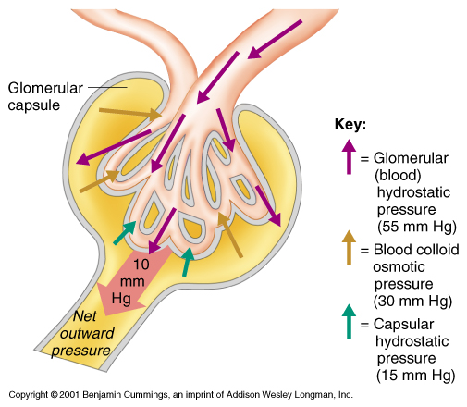
The renal glomerulus is a bundle of capillaries hosted in the Bowman’s capsule
fenestrated capillaries

Slide 12
Plasma cross flow is caused by TMP (transmembrane pressure):
TMP = hydraulic pressure difference
minus
oncotic pressure
(blood colloid osmotic pressure)

Slide 13
R
Element volume
V_{el} = πR²a + V_{RBC}
Hematocrit
⇒

Slide 14
The motion of a single element
(Newton’s law)
Pressure drop
density
Friction coefficient
Variable owing to plasma loss

Slide 15
A guess of the friction coefficient
Take
= 0.45
= 1 mm/s
=
= 40 mm Hg/mm
in the steady state equation ⇒
= 8.8⋅⋅
g/s.

Slide 16
in a 1.5mm capillary there are about 200 of such elements
⇒
It makes sense to pass to a continuous model
Divide by

Slide 17
Conservation of RBCs
To be coupled with a law for plasma outflow …
Momentum balance

Slide 18
Balance equation for plasma
external pressure
constant
Starling’s law
C = albumin concentration
RTC = “oncotic” pressure (Van’t Hoff law)

Slide 19
Dimensionless variables
(L ∼ 1.5mm)
convection time ∼ 1.5 sec

Slide 20
Momentum balance
⇒
inertia is negligible
⇒

Slide 21
Combining the RBC’s and plasma balance equations
or

Slide 22
Introducing the “filtration time”
we get the dimensionless system
compares oncotic and hydraulic pressures

Slide 23
The case of glomeruli
can be estimated, knowing that the relative change of φ during the convection time is ∼ 1/3 ⇒
We are interested in the (quasi) steady state

Slide 24
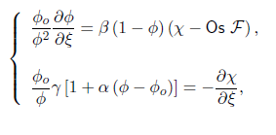
Eliminating χ …

Slide 25
A second order ODE
Cauchy data:

Slide 26
Experimenting with various friction coefficients and Os

